Slide 1
A Modern Mosque Simulation in OpenGL 3.3
Presented By
Md. Ibne Sina
Roll: 1907002
Department of Computer Science and Engineering
Khulna University of Engineering & Technology
Khulna -9203, Bangladesh.

Slide 2
Introduction
Basic Objects of the project are:
Cube
Sphare
Bezier Curve
- Dome Shape Curve
- Cylindric curve
- Circular Curve
22/01/2025
2

Slide 3
Introduction (contd.)
The components of the Modern Mosque are:
Water Fountain
Domes
Automated Door and Window
Jhar Bati
Automated Almirah
22/01/2025
22/01/2025
3

Slide 4
Functional Description
1. General Controls
• ESC → Close the window
2. Camera Movement
• W → Move forward
• S → Move backward
• A → Move left
• D → Move right
• Q → Move down
• E → Move up
3. Camera Rotation (Yaw, Pitch, Roll)
• G → Increase yaw (turn right)
• F → Decrease yaw (turn left)
• V → Increase pitch (look up)
• B → Decrease pitch (look down)
• R → Increase roll (tilt right)
• T → Decrease roll (tilt left)
4. Camera Rotation Around Look-at Point
• I → Rotate camera around the look-at point (right)
• O → Rotate camera around the look-at point (left)
22/01/2025
4

Slide 5
Functional Description (contd.)
5. Fan Rotation
• 4 → Toggle Fan 1 rotation
• 5 → Toggle Fan 2 rotation
6. Door Toggle
• 7 → Toggle double door opening
7. Chandelier (Jhar Bati) Light Toggle
• 9 → Turn Jhar Bati (chandelier) lights on/off
8. Dark Mode
• 0 → Toggle dark mode
9. Lighting Controls
• L → Toggle overall lighting on/off
• 1 → Toggle ambient lighting on/off
• 2 → Toggle diffuse lighting on/off
• 3 → Toggle specular lighting on/off
• Y → Toggle all point lights on/off
• H → Toggle directional light on/off
• N → Toggle spot light on/off
22/01/2025
5

Slide 6
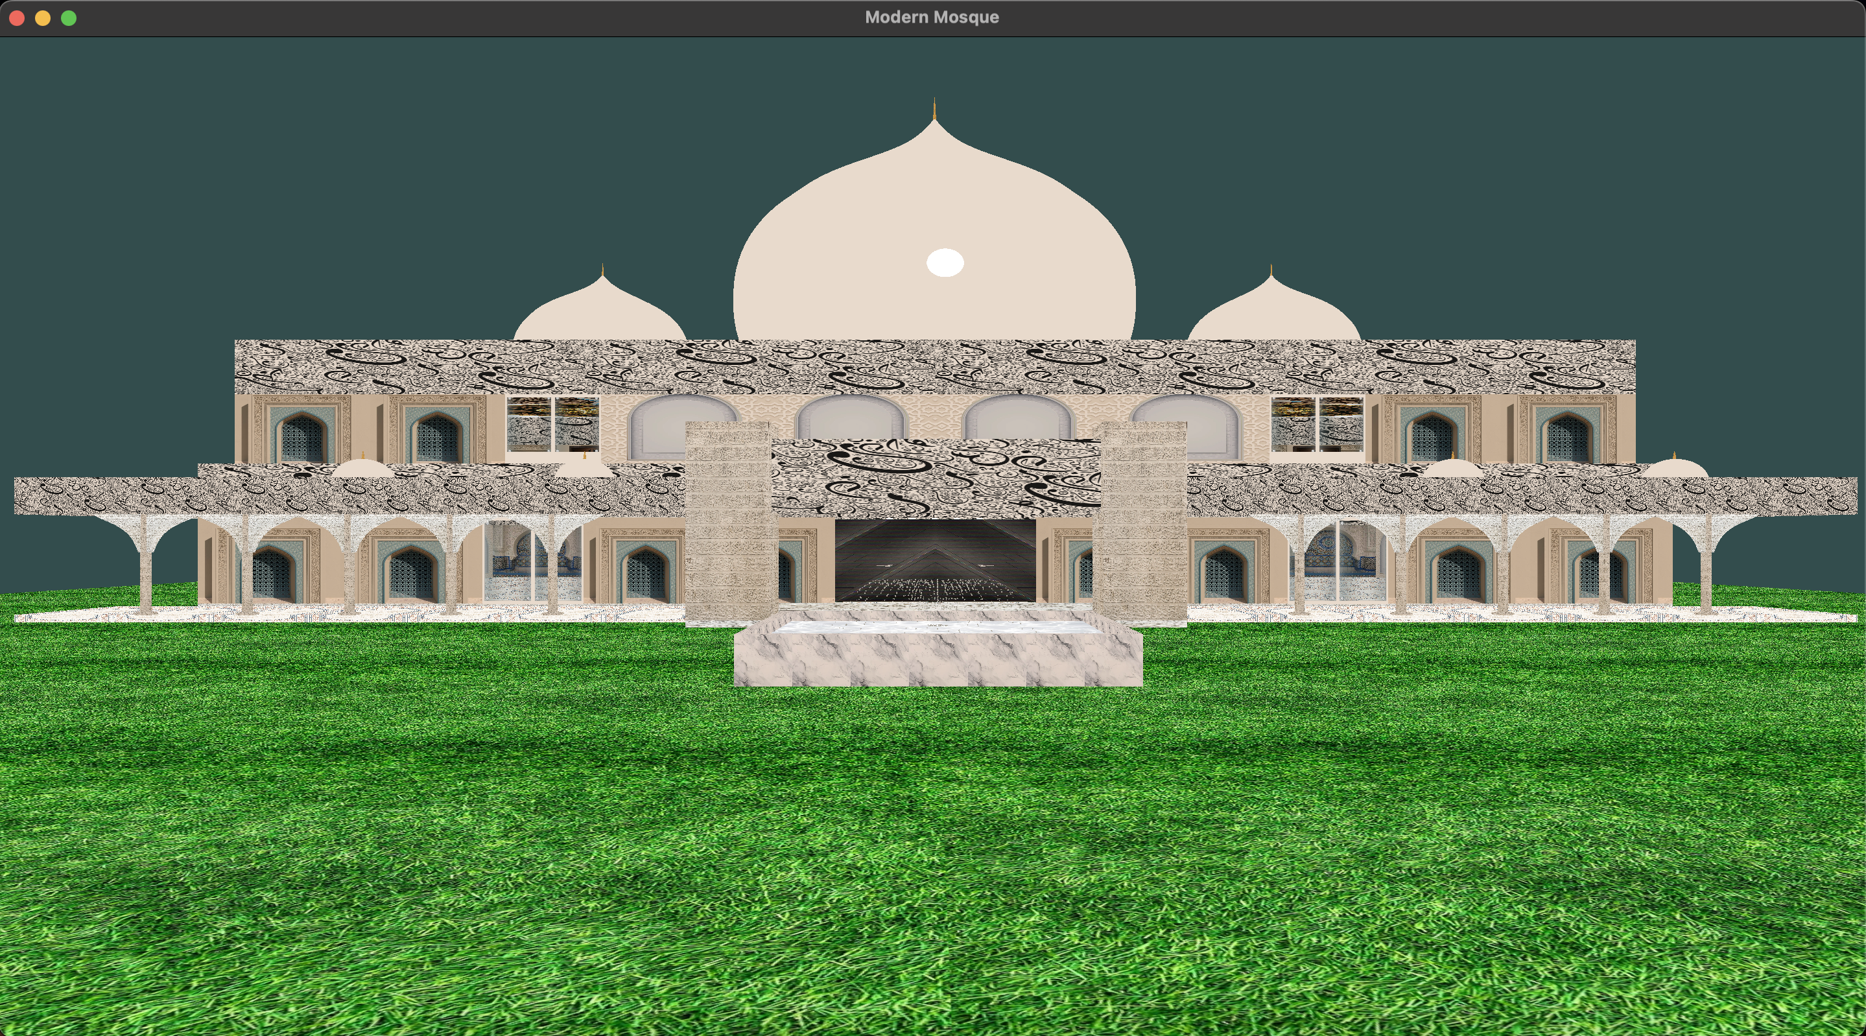
Detailed Visualization
Fig: All Lights On
22/01/2025
6

Slide 7
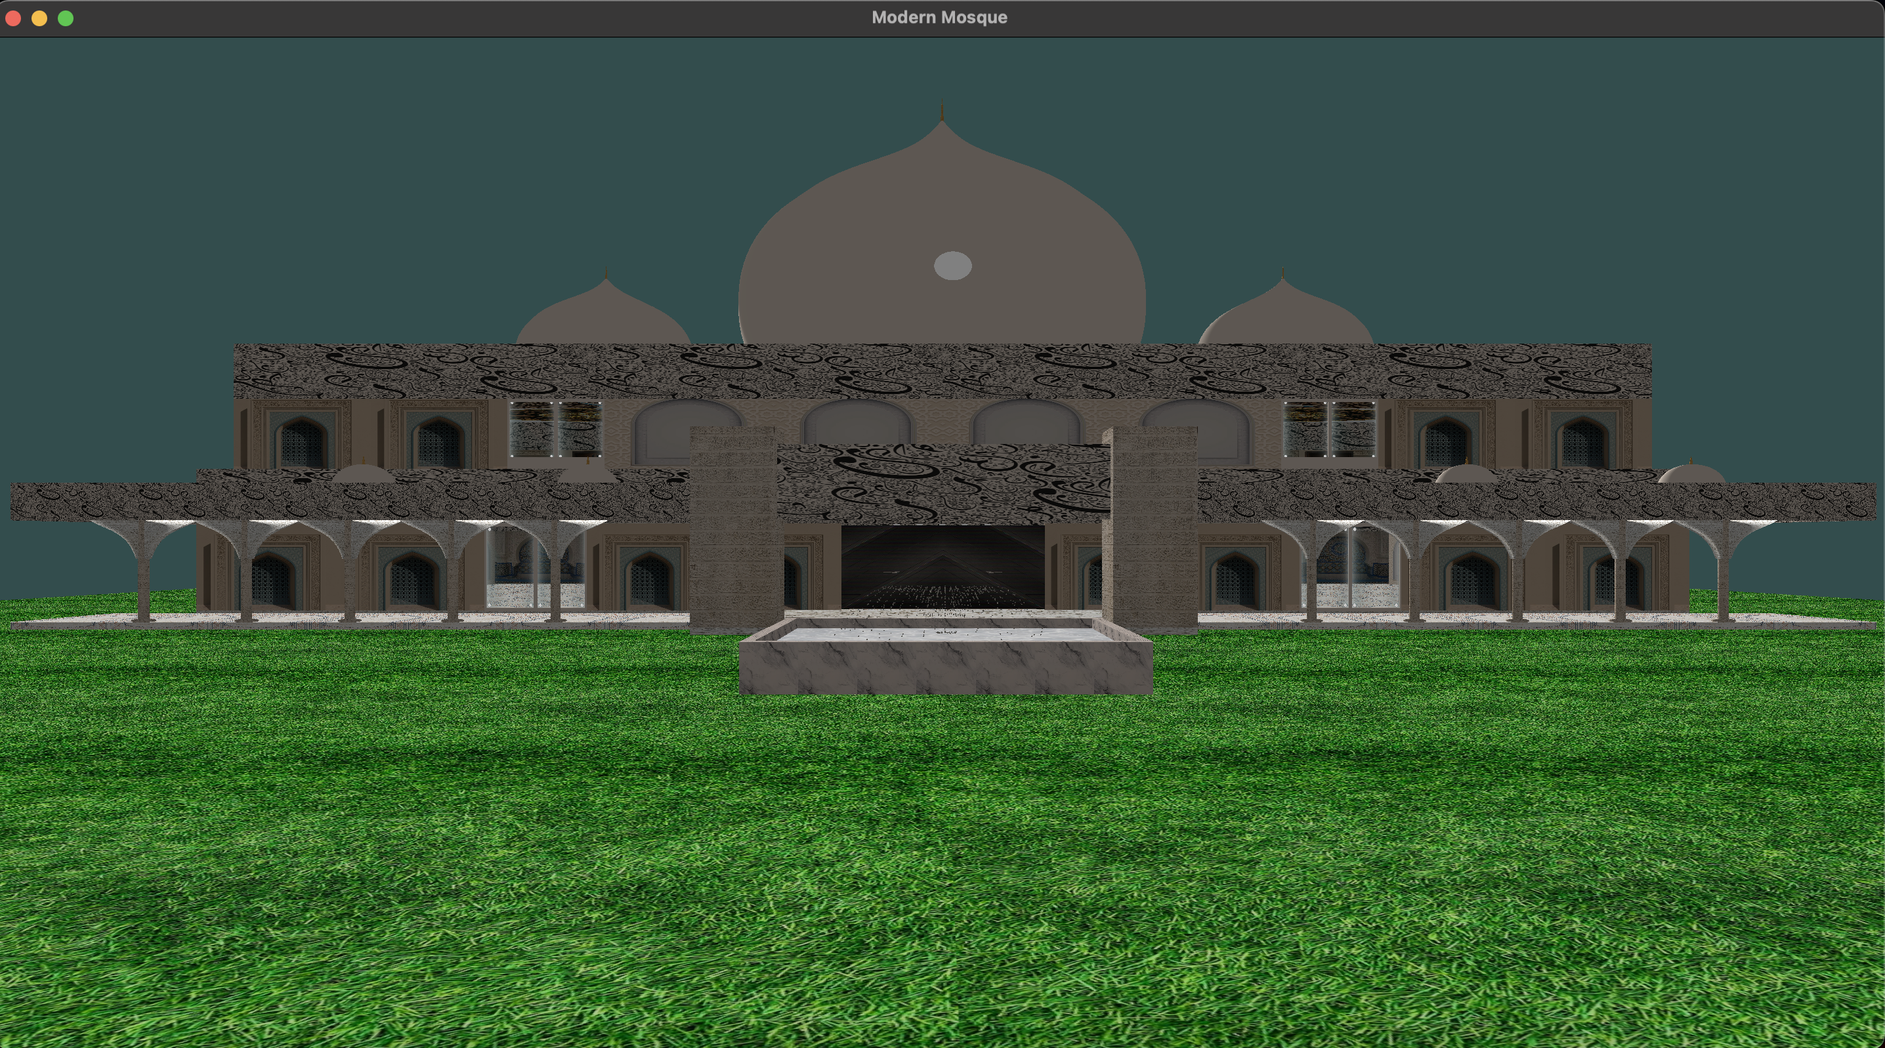
Detailed Visualization (contd.)
22/01/2025
7

Slide 8
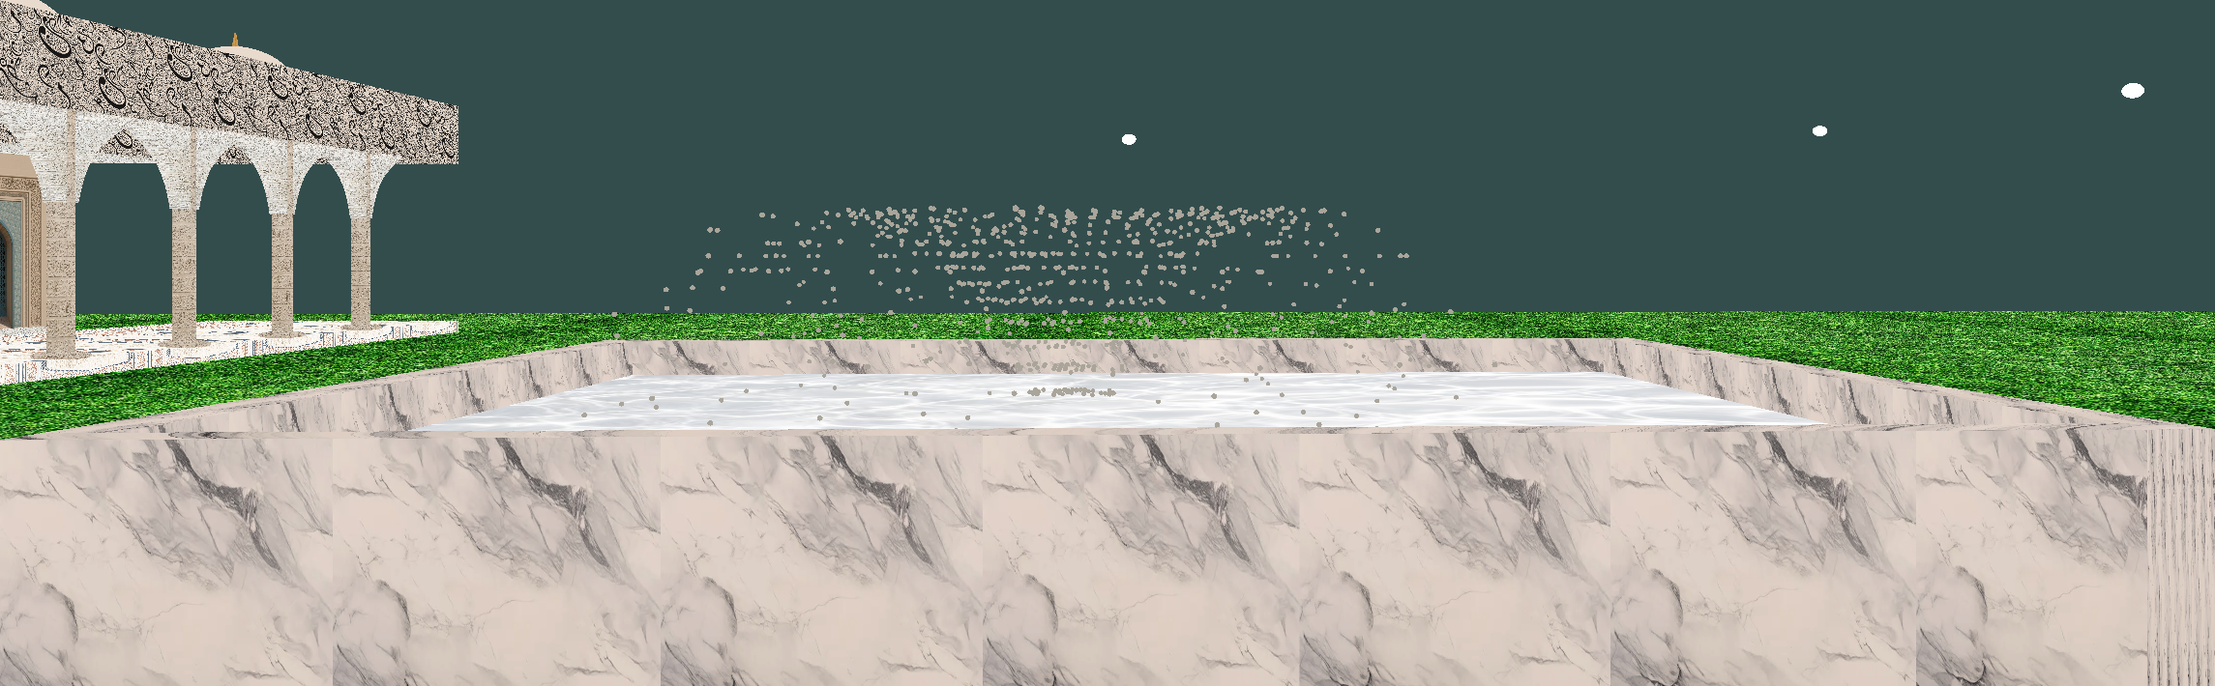
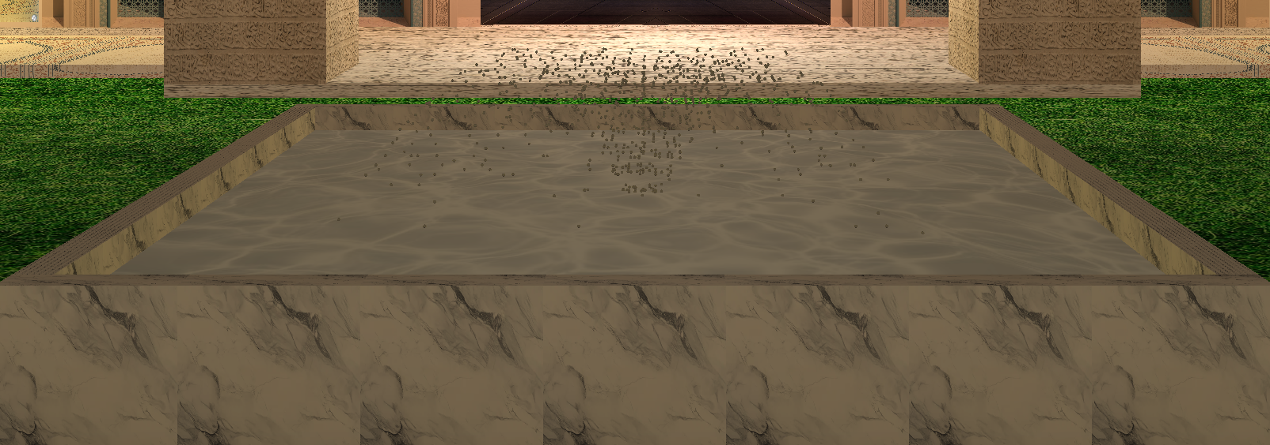
Detailed Visualization (contd.)
22/01/2025
Fig: Water Fountain
8

Slide 9
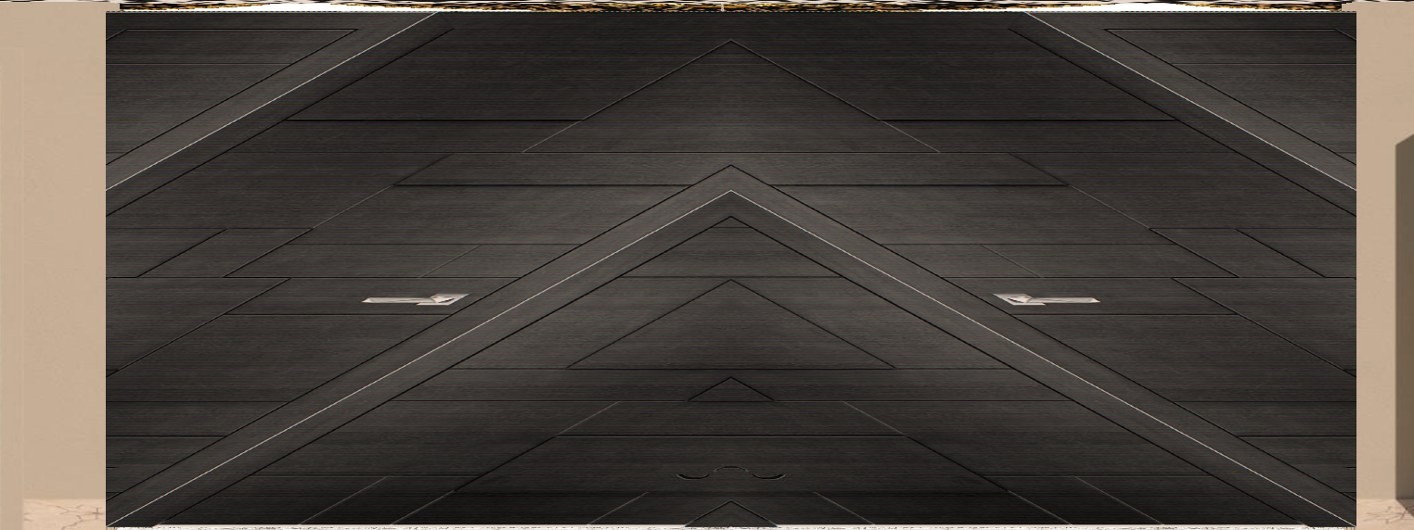
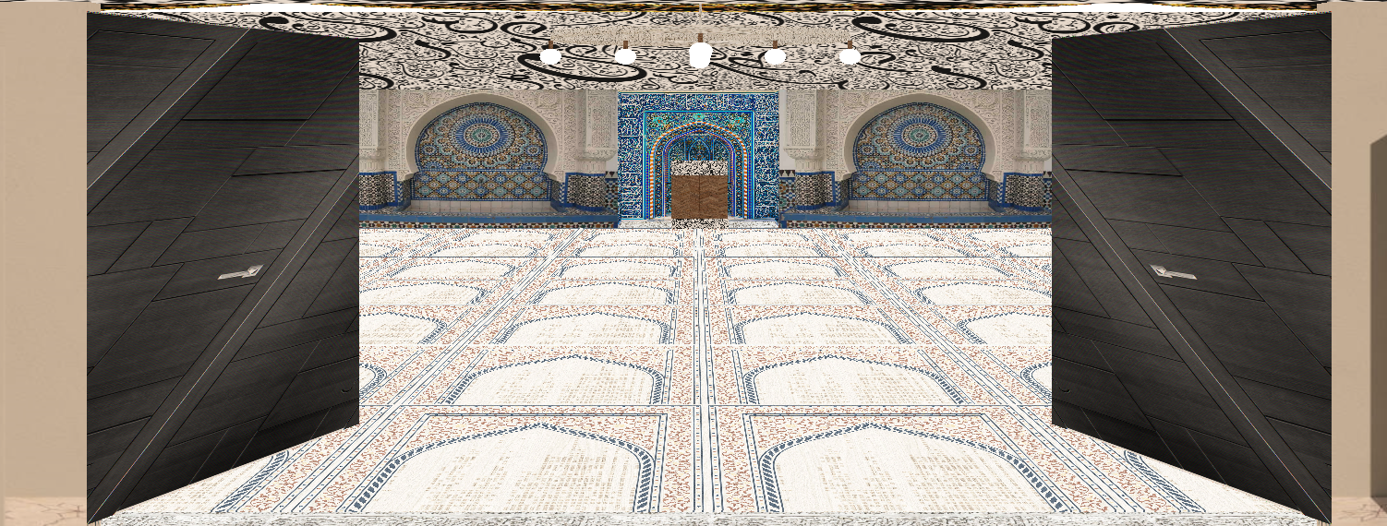
Detailed Visualization (contd.)
22/01/2025
Fig: Front Door
9

Slide 10
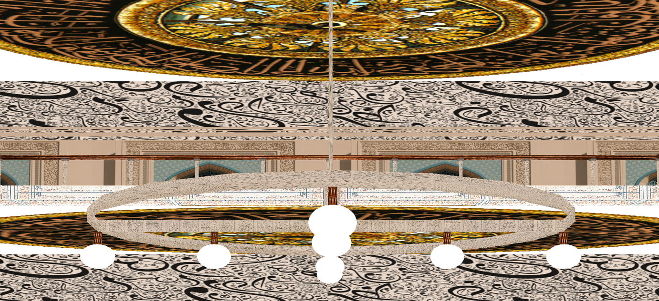
Detailed Visualization (contd.)
Fig: Jhar Bati
22/01/2025
10

Slide 11
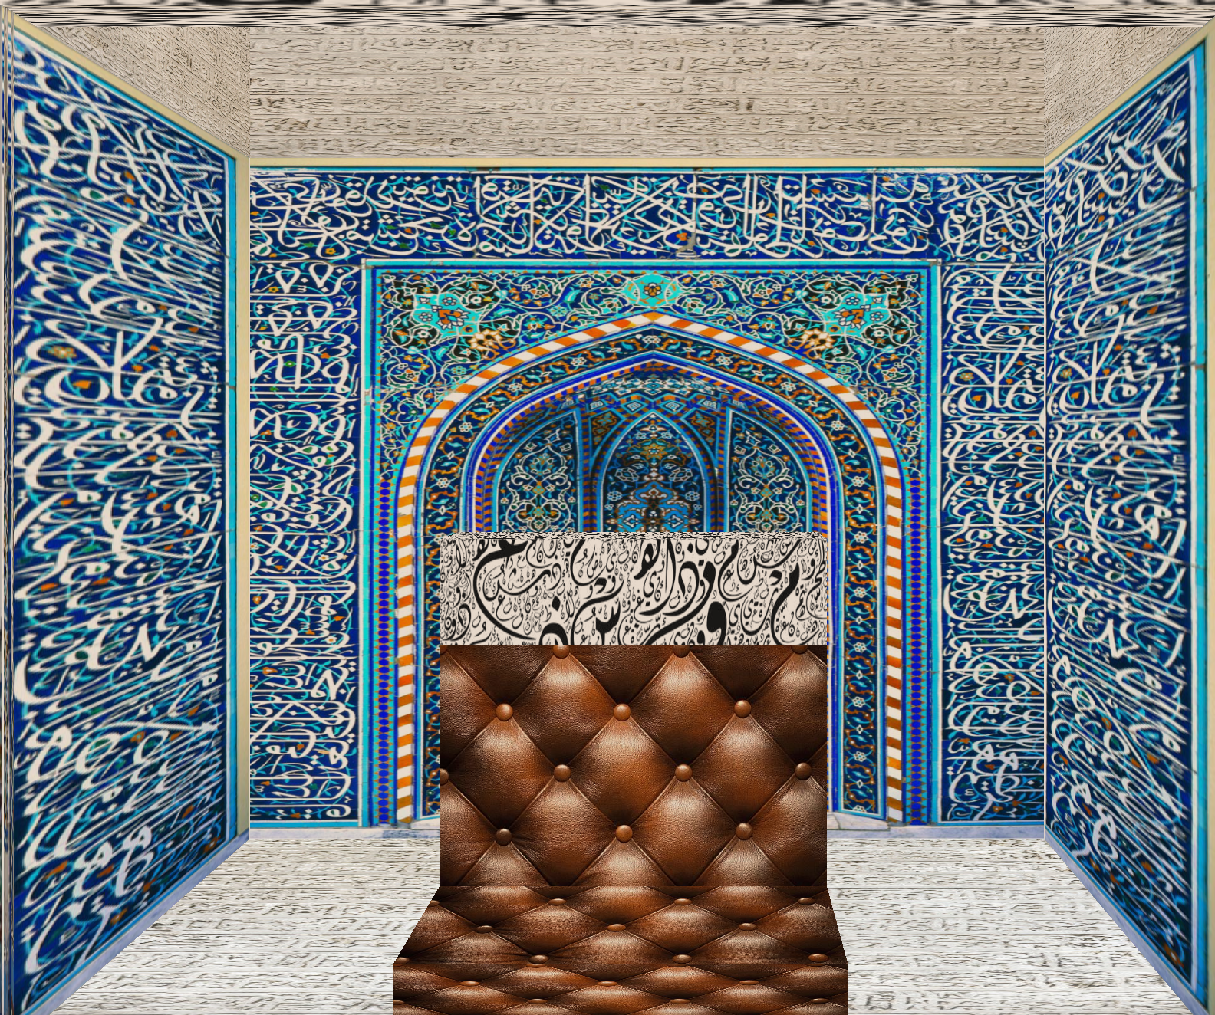
Detailed Visualization (contd.)
Fig: Imam’s Place
22/01/2025
11

Slide 12
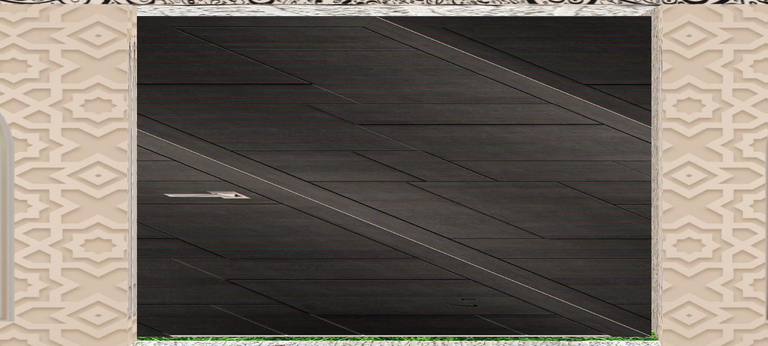
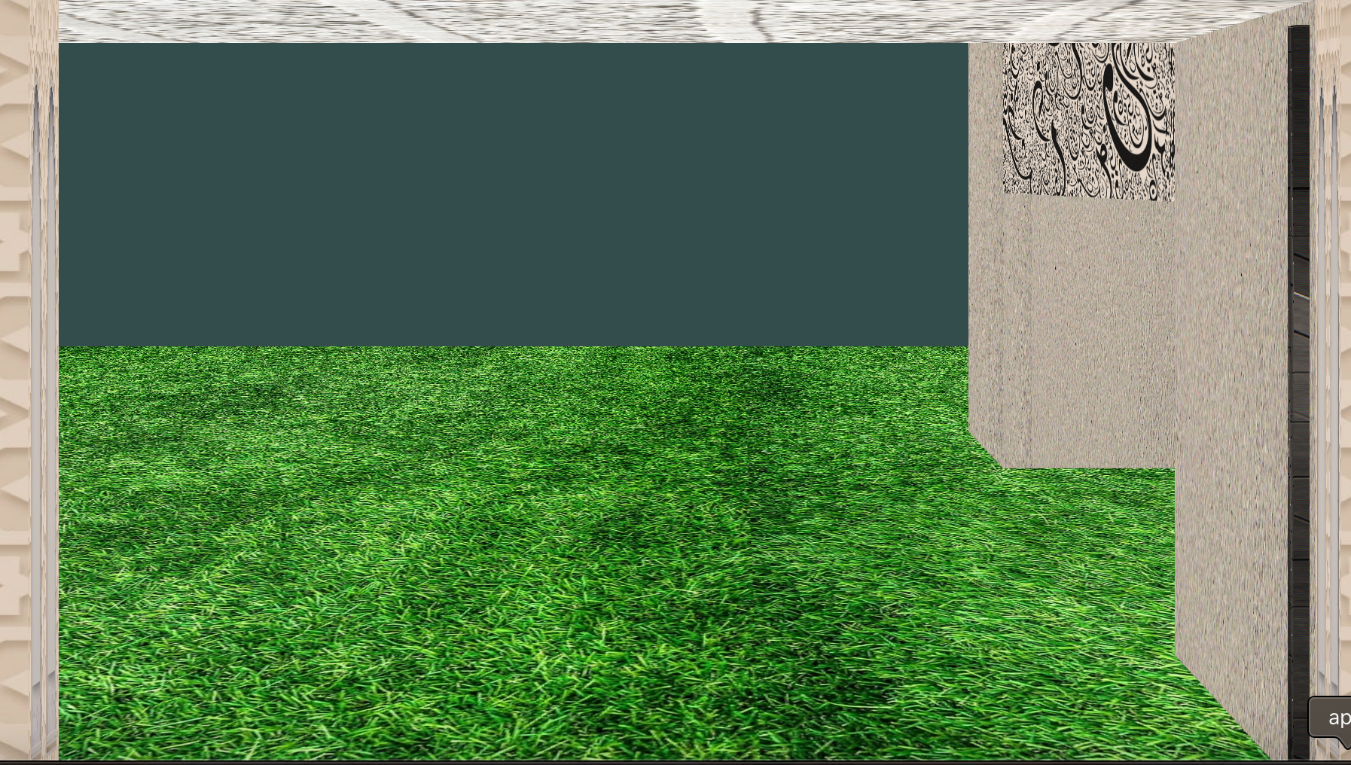
Detailed Visualization (contd.)
22/01/2025
Fig: Automated Side Door
12

Slide 13
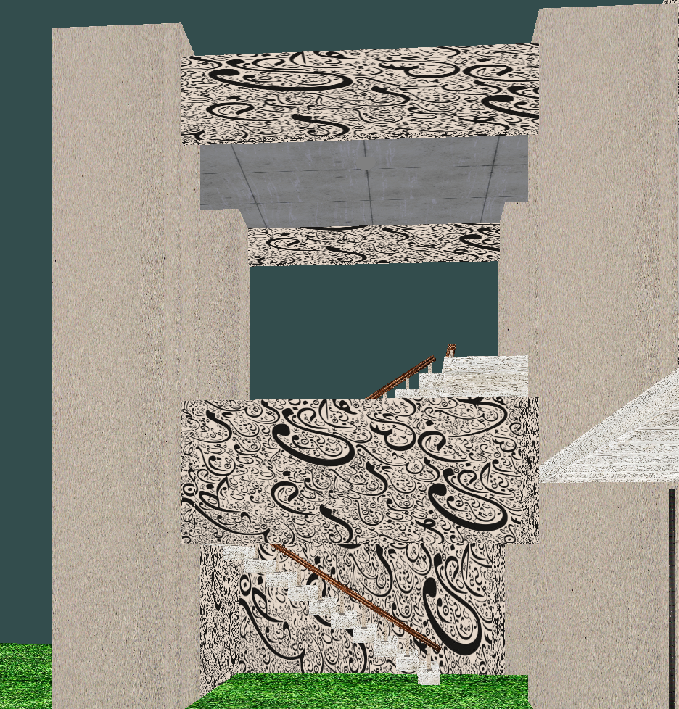
Detailed Visualization (contd.)
22/01/2025
Fig: All Lights On
13

Slide 14
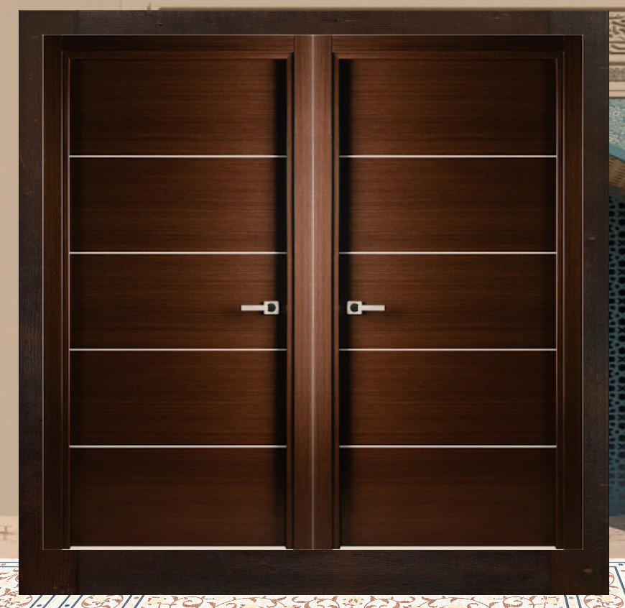
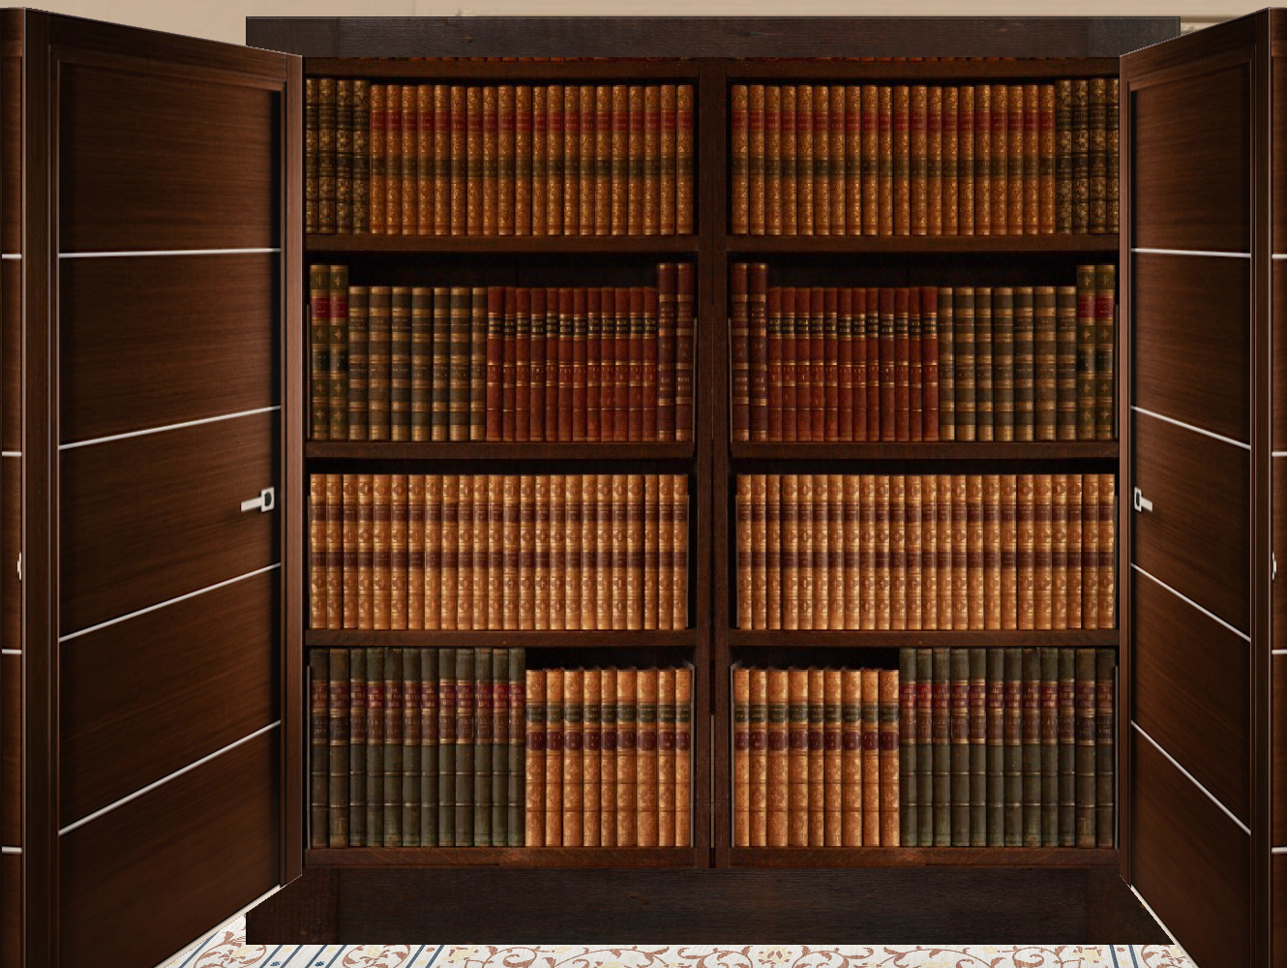
Detailed Visualization (contd.)
22/01/2025
Fig: Almirah
14

Slide 15
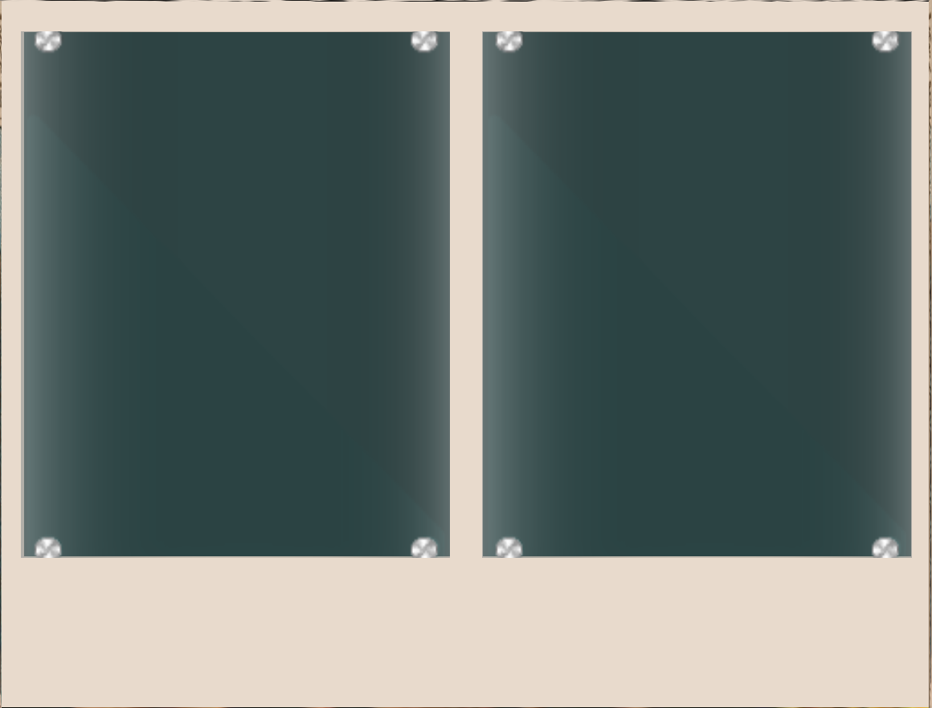
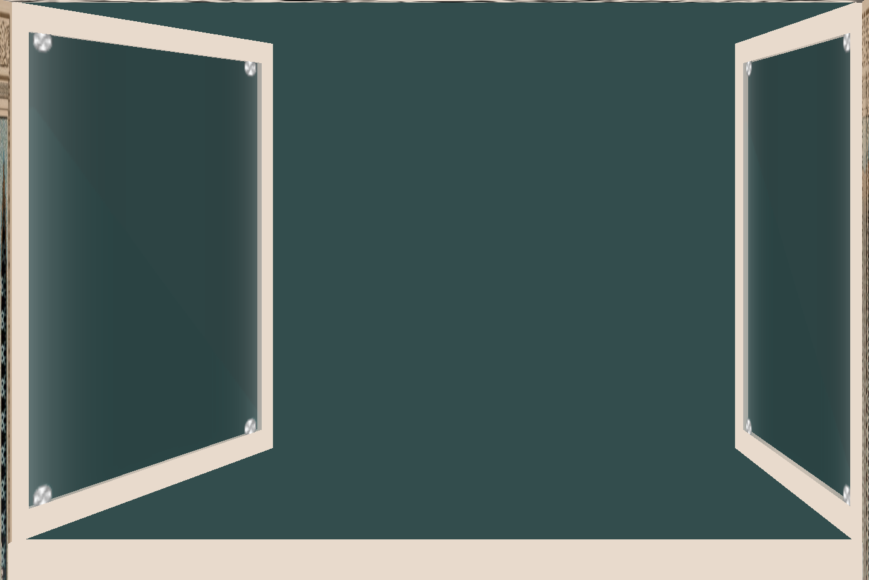
Detailed Visualization (contd.)
Fig: Automated Window
22/01/2025
15

Slide 16
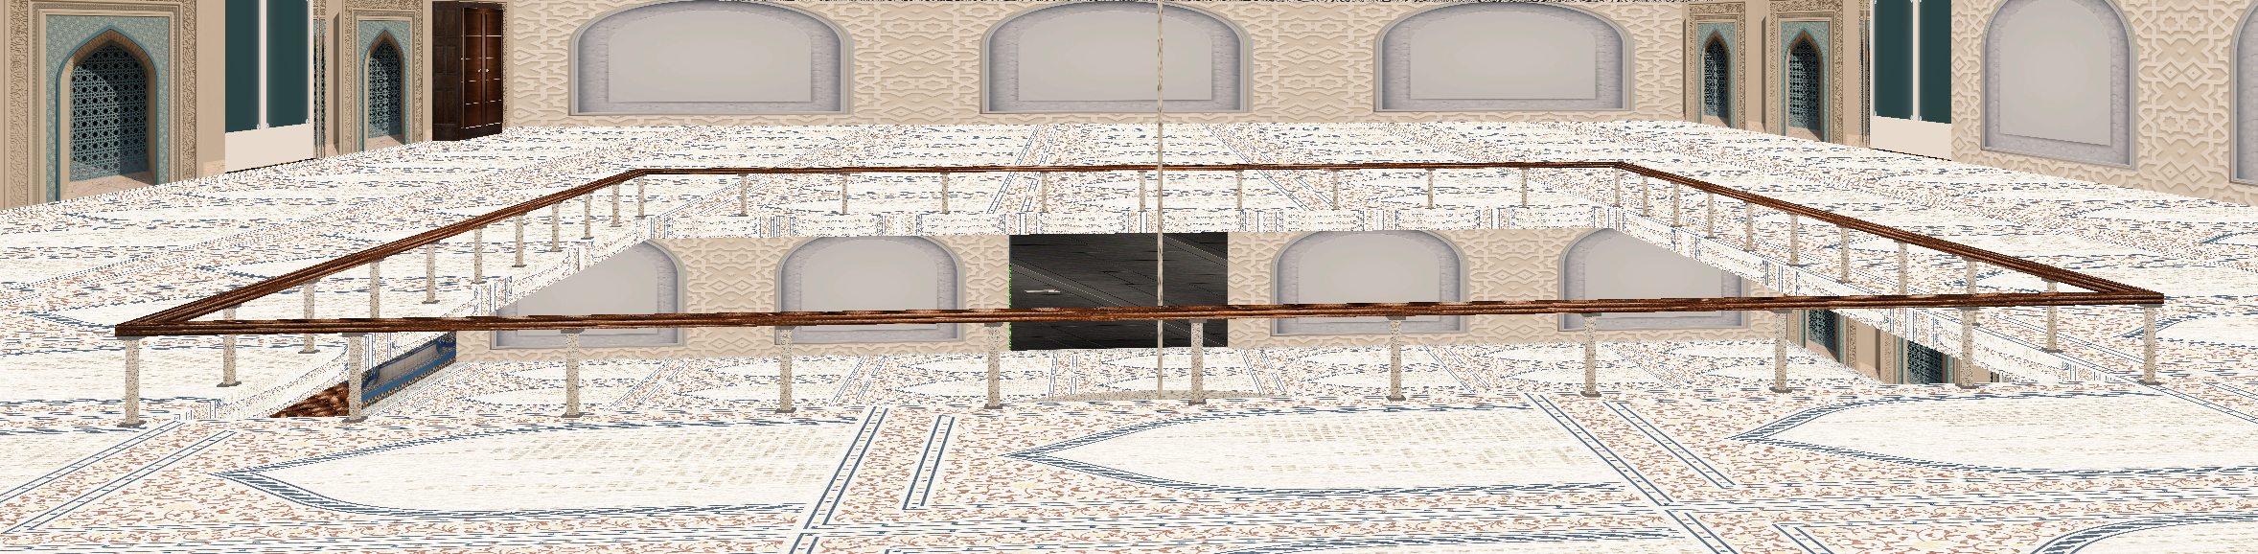
Detailed Visualization (contd.)
Fig: 2nd Floor Railing
22/01/2025
16

Slide 17
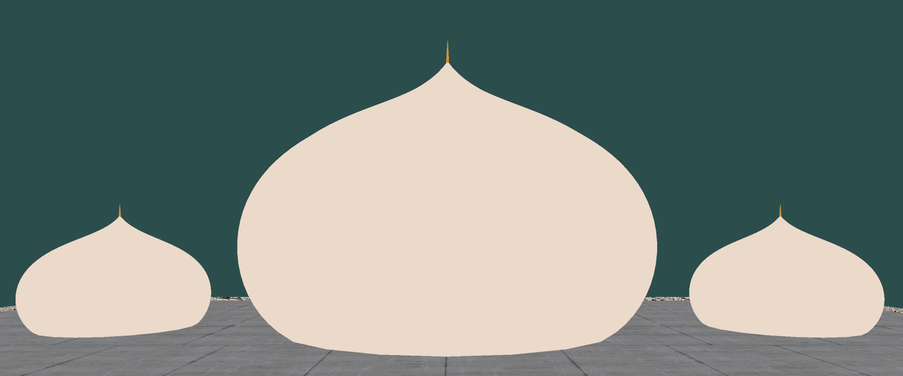
Detailed Visualization (contd.)
Fig: Domes
22/01/2025
17

Slide 18
Conclusion
What I Have Implemented:
Draw structure with Cube
Draw structure with Bezier Curve
Physics Based Movement of water particles in water fountain
Adding Texture
Implementing Roll, Pitch, YAW
Implementing Spot Light, Directional Light , Point Light
22/01/2025
18

Slide 19
Thank You

